Slide 1
SFH826 DDFCH
Design Change
Jerry Chang

Slide 2
Outline
Purpose
Features
Original Design
Purposed Modified Design
Fetching Limitation with FBD
Verification Patterns
Schedule integration

Slide 3
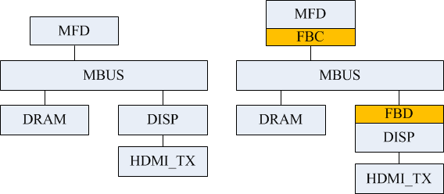
Purpose (1/2)
Pictures storage usage saving in DRAM
MBUS Bandwidth saving
In-house Frame-Buffer Integration for FBD
Multi-Frame Decoder (MFD)
Frame-Buffer Compressor (FBC)
Frame Buffer Decompressor (FBD)

Slide 4
Purpose (2/2)
In-house Frame-Buffer Integration for FBD
  2D SBUS commands translation
  data-ordering-swap interface
  Data buffering pools
Function | FBD to DDFCH
Data Type | Uncompressed raw data
Interface | Output – FBD | Input – DDFCH
Fetching Size per Read Command | 16x4 | 256x1/128x1
Fetching Size per Unit/Cycle | 8x1 | 8x1
Maximum Pixel Width | 10 | 10
Frame Scanning Order | Raster scan with 16x4 Blocks YUV420 | Raster scan, YUV422
Y/Cb/Cr Ordering | Sequential Cb/Cr: Alternate Mixing | Y: Sequential Cb/Cr: Alternate Mixing

Slide 5
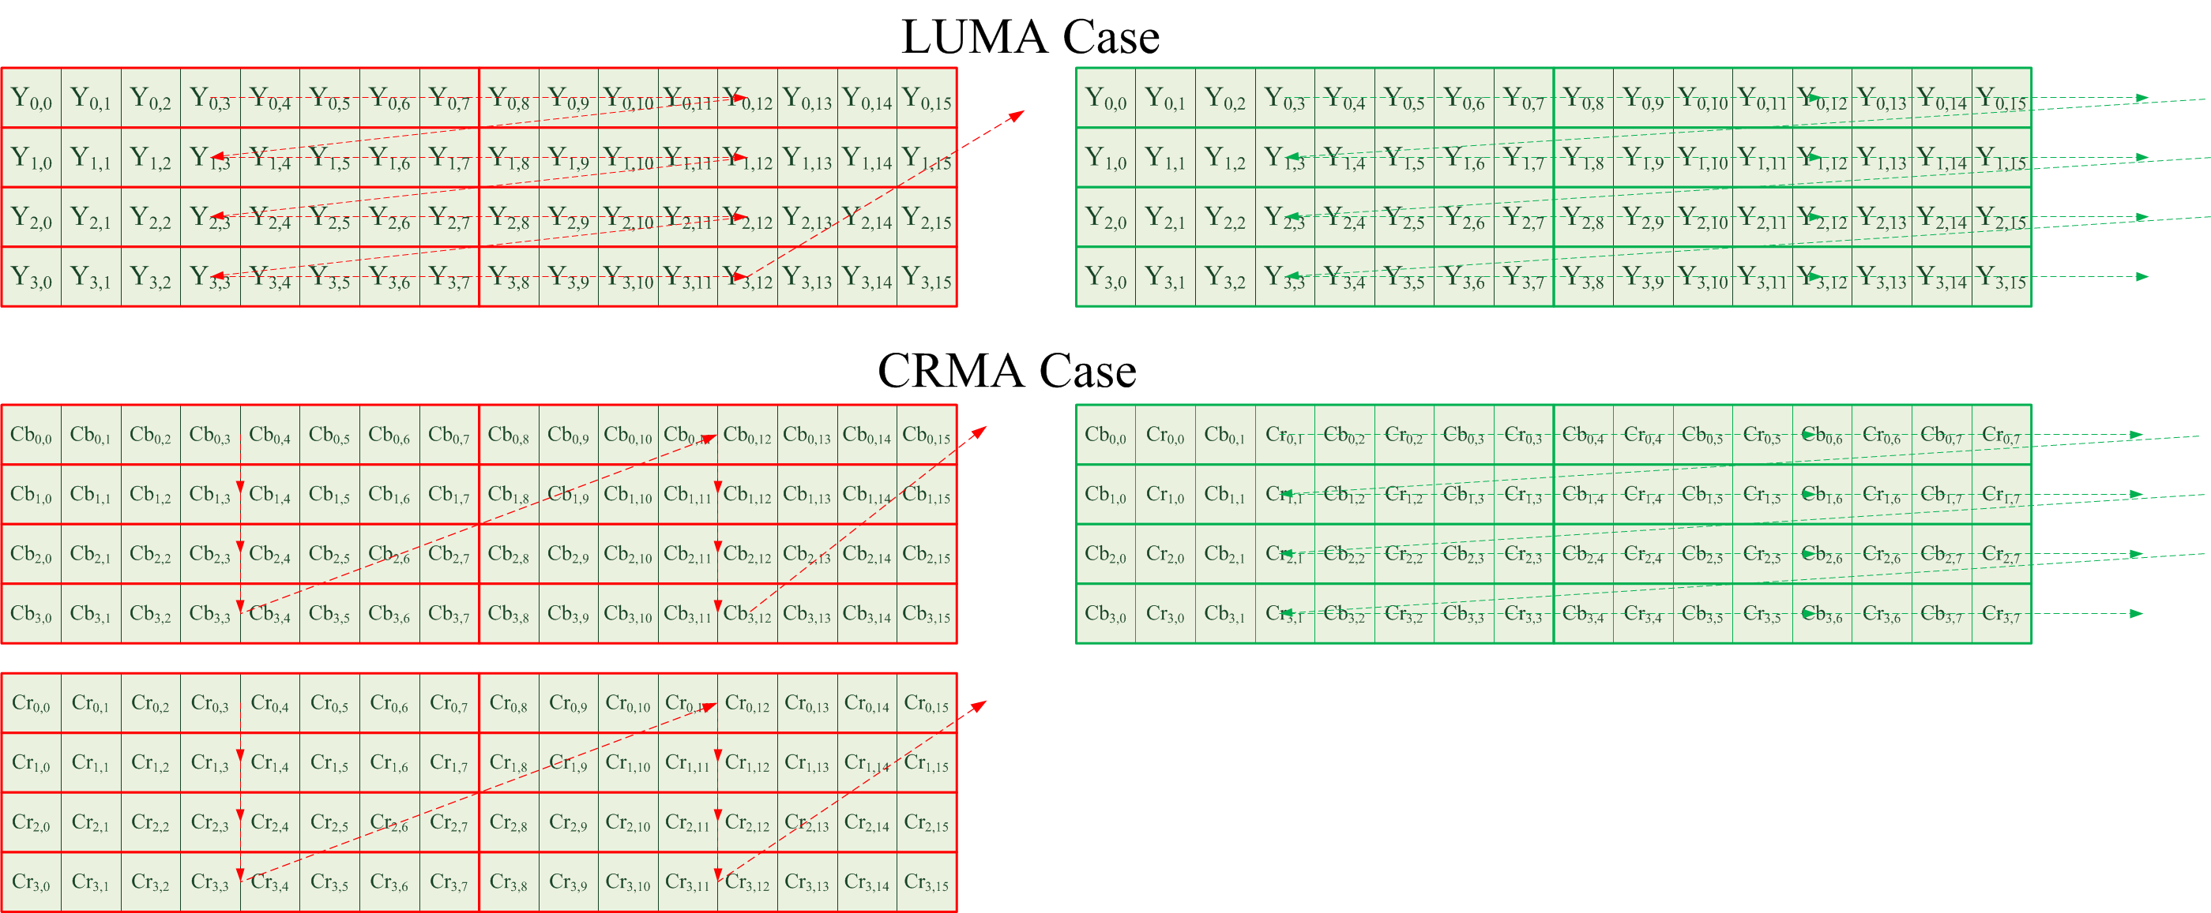
An Brief Example for Data Ordering Swap

Slide 6
Purpose (2/2)
In-house Frame-Buffer Integration for FBD
FBD decoded data Storing
  2D SBUS commands translation
  data-swap interface + data buffering pools
2D SBUS commands translation The provided interface will translate the original 2D SBUS commands and search the pre-fetched data in pools.

Slide 7
Features
Frame Data Fetching
  Support Input Formats
    Image
      Linear format (256x1, 128x1) with roster scanning.
      Maximum resolution: 1920x1080
    In-house FBD
      16x4 block size with roster scanning
      Progressive/Interlacing/H265 field mode controls
      Maximum resolution: 1920x1080
    MFD 1D Format
      1920x1080, progressive and H265 Field mode are 10 bits
      Others resolutions are 8 bits
  Design has ability to store pre-fetch image which comes from In-house FBD to reduce BUS data transfer amounts.

Slide 8
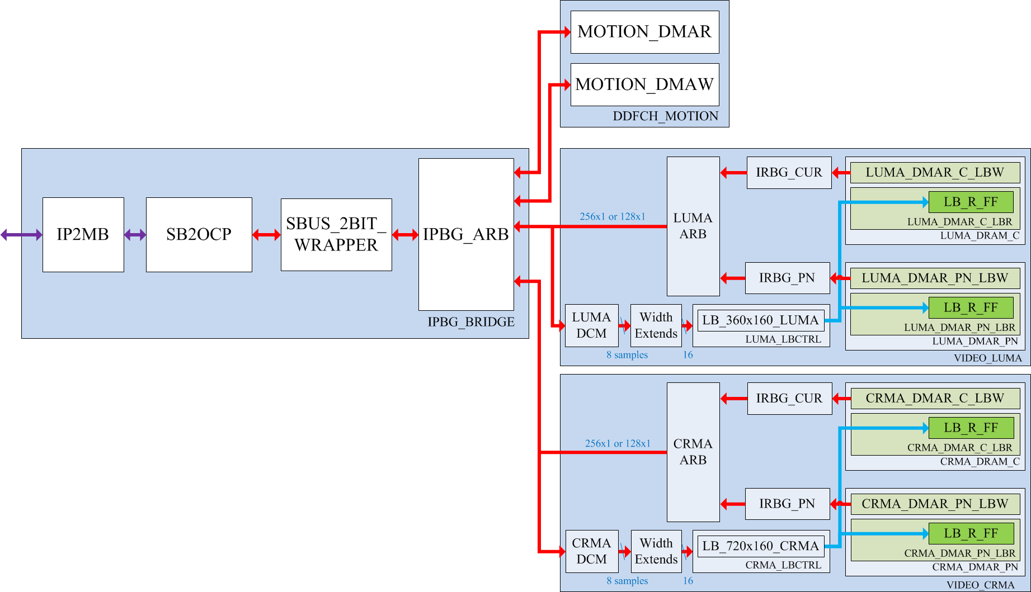
Original Design – Overview
SBUS Master Numbers:
  Motion Read : 1
  Motion Write : 1
  LUMA :3 (CURR/PRE/NXT)
  CHROMA : 3 (CUR/PRE/NXT)

Slide 9
Original Design – Fetching Characteristic (1/3)
Table. Command Type of each master
Function | Master | CMD Type
Image Display | LUMA | Linear
 | CRMA | Linear
 | MR | X
 | MW | X
Video Display | LUMA | 2D
 | CRMA | 2D
 | MR | Linear
 | MW | Linear
Table. Internal Fetching Characteristics from LUMA/CRMA masters
Mode | #BG_INDEX | Master | Line | Ordering | Field_ID=0 | Field_ID=1
Progressive | 2 | C | EVEN | Roster-scan | v | v
 |  | PRE | ODD | Roster-scan | v
 |  | NXT | ODD | Roster-scan |  | v
Interlacing | 6 | C | EVEN/ODD | Roster-scan | v | v
 |  | PRE | ODD/EVEN | Roster-scan | v | v
 |  | NXT | ODD/EVEN | Roster-scan | v | v
H265 Field | 4 | C | SEQ | Roster-scan | v | v
 |  | PRE | SEQ | Roster-scan | v
 |  | NXT | SEQ | Roster-scan |  | v

Slide 10
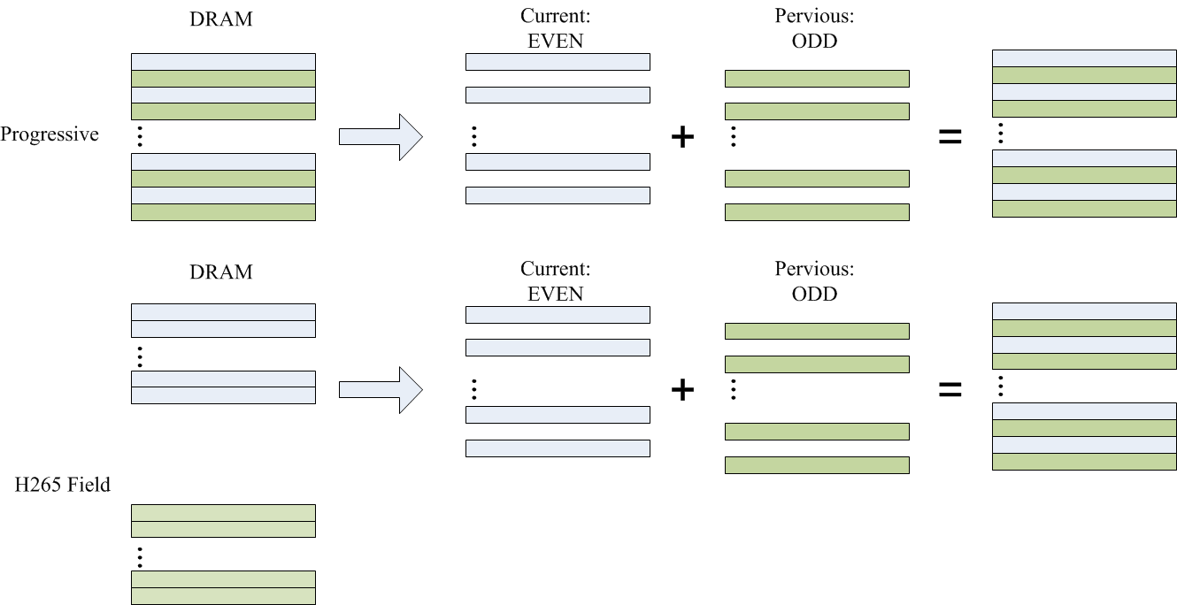
Original Design – Fetching Characteristic (2/3)

Slide 11
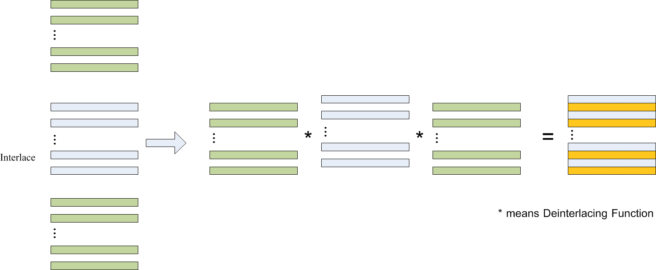
Original Design – Fetching Characteristic (3/3)

Slide 12
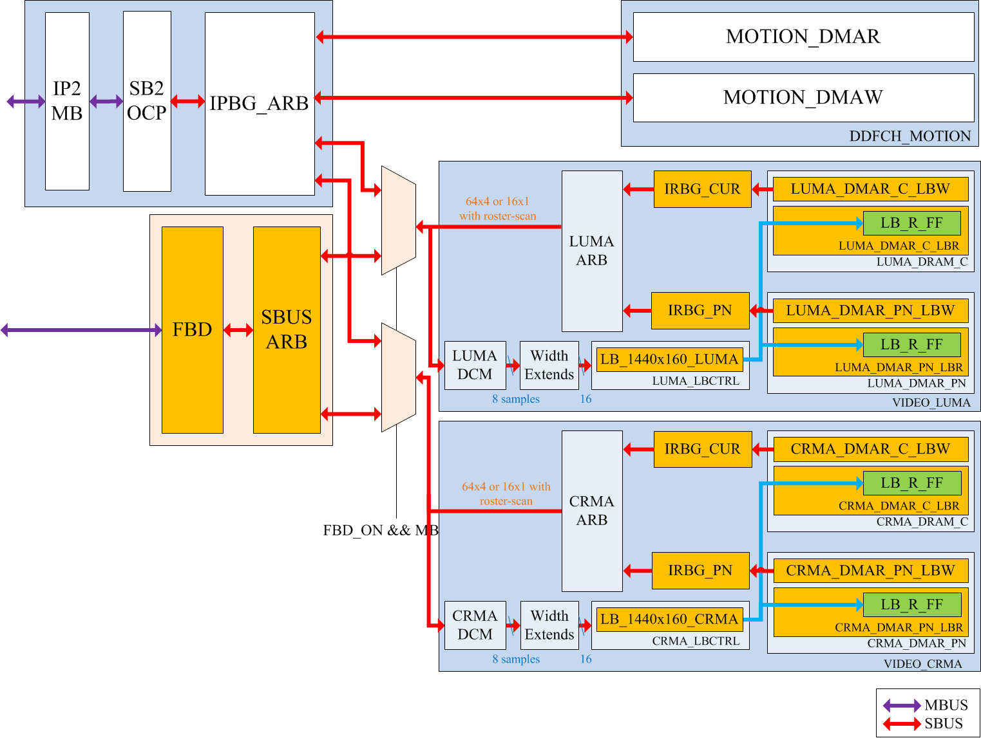
Modified Design (1/2)

Slide 13

Modified Design (2/2)
FBD
  New Design
SBUS_ARB
  Modified from IPBG_ARB
LUMA_DMAR_C_LBW
  Support 16x4/32x4/64x4 CMD when FBD is ON
IPBG_CUR/IPBG_PN
  Turn off when FBD is ON
LB_1440x160_LUMA/ LB_1440x160_CRMA
  SRAM size Extension
LUMA_DMAR_C_LBR/LUMA_DMAR_PN_LBR
CRMA_DMAR_C_LBR/CRMA_DMAR_PN_LBR
  The calculation methods for buffering counts need to modify when
    FBD is ON/OFF
    Progressive/Interlacing/H265_Field
LUMA_DMAR_C_LBW/LUMA_DMAR_PN_LBW
CRMA_DMAR_C_LBW/CRMA_DMAR_PN_LBW
  The Read address of SRAM needs to change
    when FBD is ON
    Progressive/Interlacing/H265_Field

Slide 14
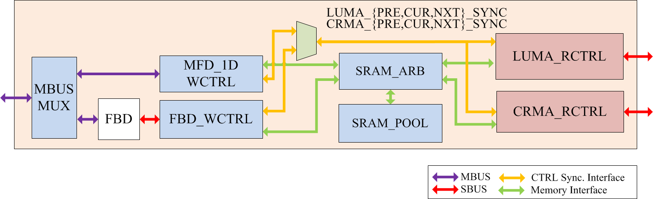
Modified Design (2/2)

Slide 15
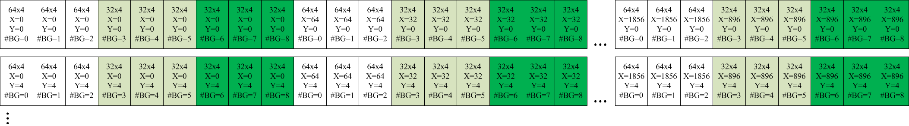
Example of Data Sequence to access FBD
Resolution: 1080I

Slide 16
SRAM Evaluation
Table I . Throughput Evaluation
Worst Case: 1080I Mode
Op. Freq (MHz) | Ideal Throughput per frame time (FPS=60)(A) | Read Cycle Times (B) | Write Cycle Times (C ) | Utilization
306 | 5100000 | 829440 | 1244160 | 36.59%
 | 306*1000*1000/60 | 2048*540*3*2/8 YUV422 | 2048*540*3*1.5*2/8 YUV420 | (B+C)/A
Conclusion: S1P is enough.
Table II . SRAM Usage with 4-lines buffering
Pool Type | Data |  |  |  | SRAM
 | Type | Width | Height | Data Width | WE | Width | Height | Size
Current | Y | 1920 | 4 | 160 | 4 | 160 | 480 | 76800
 | Cb | 960 | 4 | 160 | 4 | 160 | 240 | 38400
 | Cr | 960 | 4 | 160 | 4 | 160 | 240 | 38400
Pervious | Y | 1920 | 4 | 160 | 4 | 160 | 480 | 76800
 | Cb | 960 | 4 | 160 | 4 | 160 | 240 | 38400
 | Cr | 960 | 4 | 160 | 4 | 160 | 240 | 38400
Next | Y | 1920 | 4 | 160 | 4 | 160 | 480 | 76800
 | Cb | 960 | 4 | 160 | 4 | 160 | 240 | 38400
 | Cr | 960 | 4 | 160 | 4 | 160 | 240 | 38400
Total |  |  |  |  |  | 80 | 3072 | 56.3KBs

Slide 17
Fetching Limitation with FBD
¡
  No difference in Fetching, keeps original method
  No increased BUS data amount increment.
r
  Additional cropping lines when Y-axis is not the times of 4 or 8
  A-little-bit BUS data amount increment.
p
  Can not bypass any fetching lines via Vertical Decimation due to the basic unit minimum fetching lines is 4
  Extremely BUS data amount increment.
Function | Fetching Data Format | Cropping | Decimation
 |  |  | Vertical | Horizontal
Image Display | Linear | ¡ | ¡ | ¡
Video Display | Progressive | r | p | ¡
 | Interlacing | r | p | ¡
 | H265 Field | r | p | ¡

Slide 18
Pattern Lists
Compressed Pattern
480P_FBD_Frame
480P_FBD_Field
480I_FBD
576P_FBD_Frame
576P_FBD_Field
576I_FBD
720P_FBD_Frame
720P_FBD_Field
1080P_FBD_Frame
1080I_FBD_Frame
1080P_FBD_Field
1080I_FBD_Frame_8bit
1080P_FBD_Field_8bit
1080I_FBD_Frame_10bit
1080P_FBD_Field_10bit
Non-Compressed Pattern
1080P_Linear
1080I_Linear
1080P_MFD_1D_8bit
1080I_MFD_1D_8bit
1080I_MFD_1D_10bit
1080P_MFD_1D_10bit
Functions
DCM2
DCM4
Cropping-X Pixels 0 to 7
Cropping-Y Line 0 to 7

Slide 19
To-Do JOBs
Script or simulation model for patterns
  FBD models
  MFD 1D data in DRAM
  Pattern create for pattern lists via pattern gen
RTL Coding
  SRAM_POOL design
  FBD WCTRL/RCTRL
Verification
  Pattern create for pattern lists

Slide 20
Design Notes
handling the rest pixel data when width <64. Need to separate them into the times of 16 or 32.

Slide 21




Rotation
Function
  0 degrees
  90 degrees
  180 degrees
  270 degrees
  Mirror
  Upside down
(0,0)
(1919,0)
(0,1079)
(1919,1079)

Slide 22
Rotation
0
1
0 degrees
  Read from DRAM
    Roster-Scan with 16x4
  Write to DISP
    Roster-Scan
2
3
4
5
6
7
0
1
2

Slide 23
Function
  90 degrees
    Read from DRAM
      Start y_pos = HEIGHT/4
      Start x_pos = 0
      Roster-scan among y-axis
    Write to DISP
      Roster-Scan
(0,128)
(0,0)
4
6
2
0
5
7
3
1
(1919,64)
(1919,0)

Slide 24
7
6
  180 degrees
  Read from DRAM
    Base Address
5
4
3
2
1
0
(1919,1079)
(0,1079)
(1919,0)
(0,0)

Slide 25
270 degrees
(1919,0)
(1919,1079)
3
1
5
7
2
0
4
6
(0,0)
(0,1079)

Slide 26
1
0
  Mirror
3
2
5
4
7
6
0
1
2

Slide 27
  Upside down
6
7
4
5
2
3
0
1
(0,1079)
(1919,1079)
(0,0)
(1919,0)

